Slide 1
Improved source of drinking water
CAPSTONE PROJECT
Presented By: Aaditya Singh Tariyal
Faculty name: Aman Srivastava
College name & department-Haridwar University-CSE AI-ML

Slide 2
OUTLINE
Problem Statement
Proposed System/Solution
System Development Approach
Algorithm & Deployment
Result (Output Image)
Conclusion
Git-hub Link
Future Scope
IBM Certifications
References

Slide 3
Problem Statement
Problem Statement:
Policymakers and researchers struggle to identify localized gaps in water security due to the complexity of the NSS 78th Round (MIS) data. Traditional analysis fails to account for how migration patterns and clean energy shifts (cooking fuel) create hidden inequalities in drinking water access, leading to inefficient resource allocation and stalled progress on SDG 6.
Proposed Solution:
A Predictive Water Analytics Engine built on IBM watsonx.ai that utilizes the SnapBoostingMachineRegressor (Snap ML). This high-performance model integrates socio-economic indicators and migration trends to predict water scarcity clusters with 10x faster processing than standard ML. The solution provides a real-time dashboard for "what-if" policy simulations, enabling targeted infrastructure interventions for India’s most vulnerable regions.

Slide 4
Proposed Solution
Proposed Solution: Predictive Water Security Framework
1. Data Collection
Primary Source: AI Kosh / IndiaAI Dataset.
Key Indicators: Access to improved sources (piped, tube well), distance to source, availability of clean cooking fuel (LPG/PNG), and migration history (rural-to-urban shifts).
Ingestion: Data is pulled into watsonx.ai via the ibm-watson-machine-learning API, ensuring secure handling of large-scale survey microdata.
2. Preprocessing
Feature Engineering: Conversion of categorical survey codes into numerical vectors; calculating a "Water Accessibility Index" by weighting source type and distance.
Handling Sparsity: Use of watsonx AutoAI to automatically handle missing values and perform feature selection, identifying high correlation between clean cooking fuel usage and water infrastructure.
Data Scaling: Normalization of socio-economic variables to ensure unbiased model convergence.
3. ML Algorithm: SnapBoostingMachineRegressor
The Engine: Implementation of the Snap ML library’s SnapBoostingMachineRegressor.
Optimization: Utilizes GPU-accelerated training to process the MIS dataset’s hundreds of thousands of household entries in seconds.
Hybrid Learning: The model combines gradient boosting trees with linear solvers, allowing it to capture both sudden disparities (geographic) and gradual trends (migration impacts).
4. Evaluation
Metrics: Root Mean Squared Error (RMSE) for accessibility scores and R-squared ($R^2$) to determine the variance explained by socio-economic factors.
Cross-Validation: K-fold validation to ensure the model generalizes across different Indian states with varying topographies.
Explainability: Use of LIME or SHAP within watsonx to provide "Global Feature Importance," showing policymakers exactly why certain regions are falling behind.
5. Deployment
Runtime: Deployed as a scalable REST API on IBM Cloud (WML) using the AutoAI-generated Experiment Notebook.
Interface: Integration with a "Policy Simulator" dashboard where users can adjust migration or fuel-subsidy variables to predict future water accessibility levels.

Slide 5
System Approach
System Requirements
Infrastructure: IBM watsonx.ai Runtime / Cloud Pak for Data.
Compute: Python 3.10+, 16GB RAM, GPU-enabled environment for Snap ML acceleration.
API Access: IBM Cloud API Key and Watson Machine Learning (WML) service instance.
Input Data: NSS 78th Round MIS Dataset (CSV/Parquet) from AI Kosh.
2. Libraries & Technical Stack
Core Engine: snapml (SnapBoostingMachineRegressor) for ultra-fast training.
AutoAI Integration: autoai-libs and lale for automated pipeline refinement.
IBM Ecosystem: ibm-watson-machine-learning for model lifecycle management.
Data Science: pandas, numpy, and scikit-learn for preprocessing and metrics.
3. Implementation Workflow
Ingestion: Secure data loading via WML API.
Transformation: Auto-feature engineering for water/fuel indicators.
Modeling: Training the Snap ML Regressor on household survey data.
Deployment: Persisting the pipeline as a REST API via watsonx Experiment Notebook.

Slide 6
Algorithm & Deployment
Algorithm Selection: SnapBoostingMachineRegressor
Overview: A high-performance boosting framework within the Snap ML library, optimized for massive datasets and multi-threaded CPU/GPU environments.
Justification: Unlike standard regressors, Snap ML captures non-linear socio-economic patterns in the NSS 78th Round (276k+ records) with up to 10x faster training, making it ideal for the high-cardinality features of Indian survey data.
Data Input
Core Features: Primary source of drinking water, distance to source, and household location (Rural/Urban).
Correlative Features: Type of cooking fuel (LPG/Biomass), migration status (rural-to-urban shifts), and household social group.
Target: Water Accessibility Index (calculated composite score).
Training & Prediction Process
Training: Executed via watsonx AutoAI using $k$-fold cross-validation and automated hyperparameter optimization to minimize RMSE.
Prediction: The model processes new household survey inputs to predict water security gaps. It uses a heterogeneous ensemble approach, blending trees with linear solvers for maximum accuracy.
Deployment on watsonx.ai
Hosting: The model is persisted into a Watson Machine Learning (WML) Deployment Space.
Integration: Deployed as an Online REST API Endpoint, allowing external dashboards to send household data and receive real-time water security predictions.
Monitoring: Uses watsonx "Evaluate" features to track model drift and fairness across different states.

Slide 7
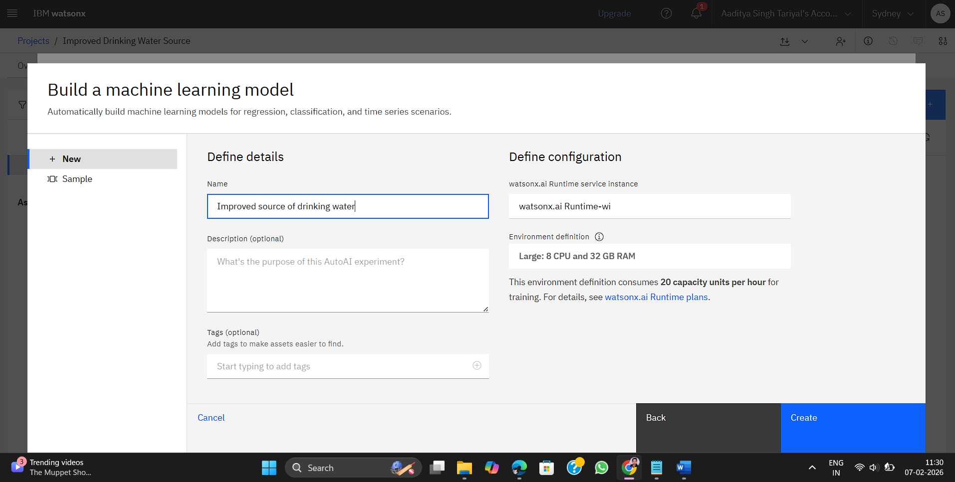
PROCESS PHASE
Specifying runtime instance

Slide 8
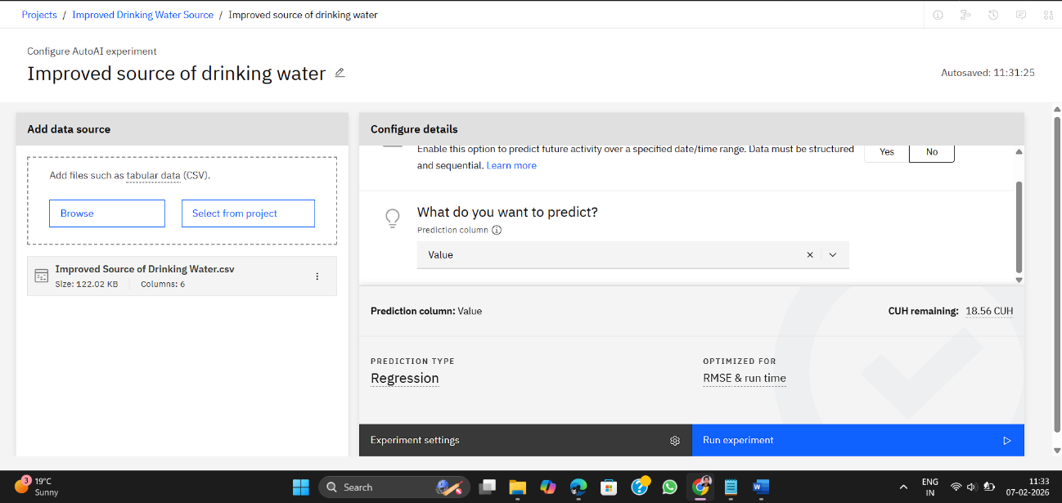
PROCESS PHASE
feature model will predict
Dataset for our project

Slide 9
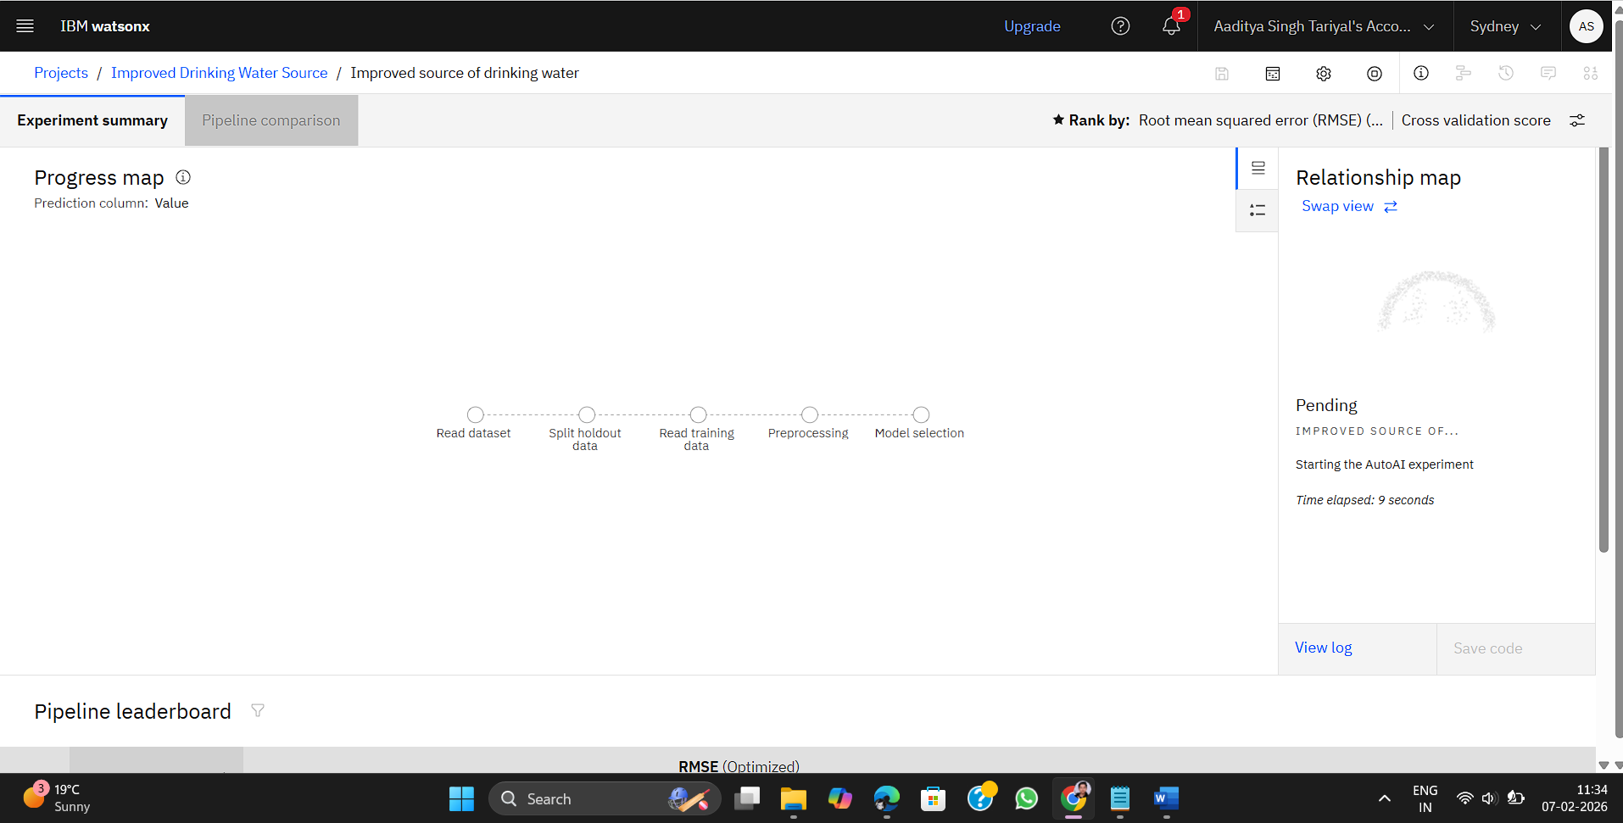
PROCESS PHASE
Phases dataset goes through over WATSONX

Slide 10
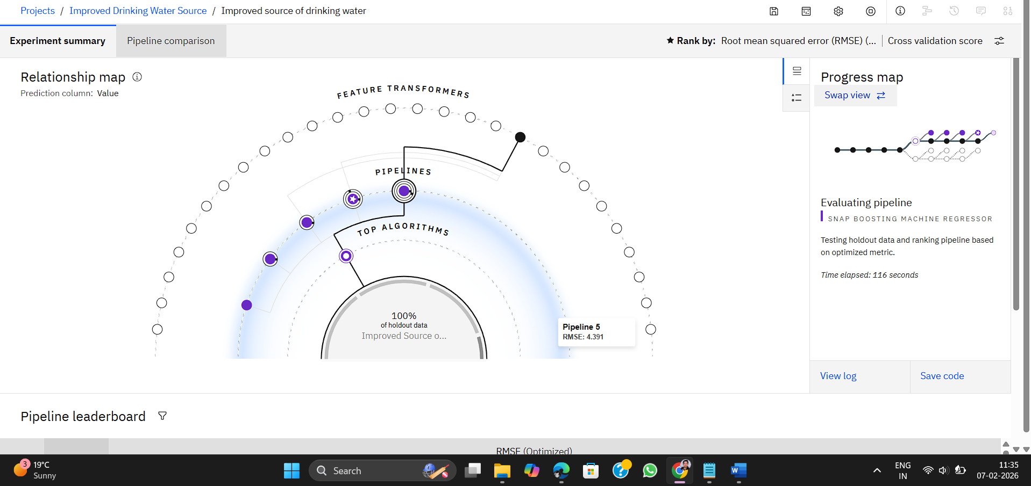
PROCESS PHASE

Slide 11
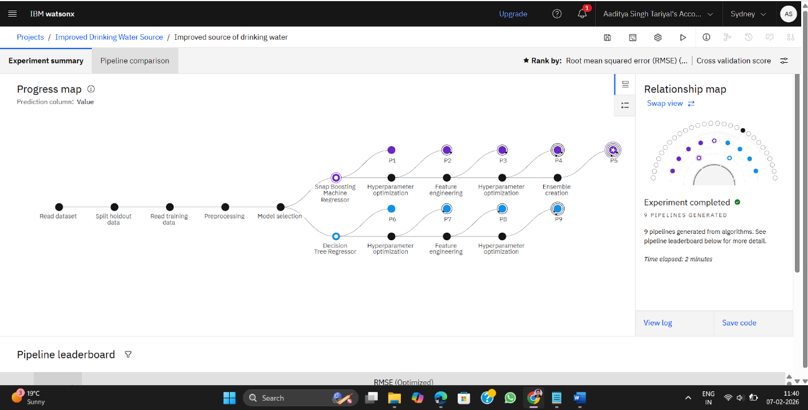
Result
Most Optimal Model
ML Algorithms implemented

Slide 12
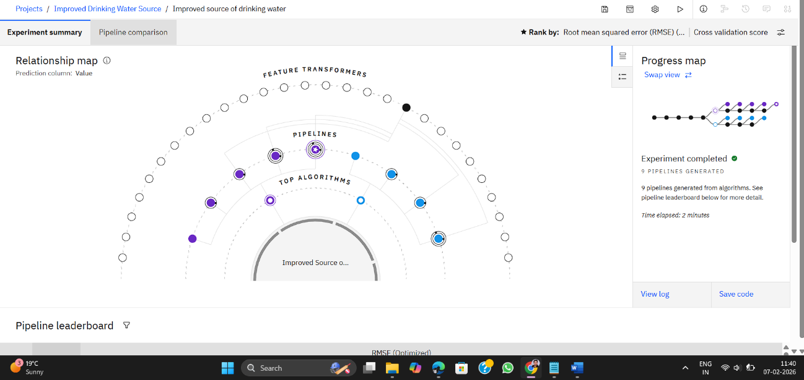
Result

Slide 13
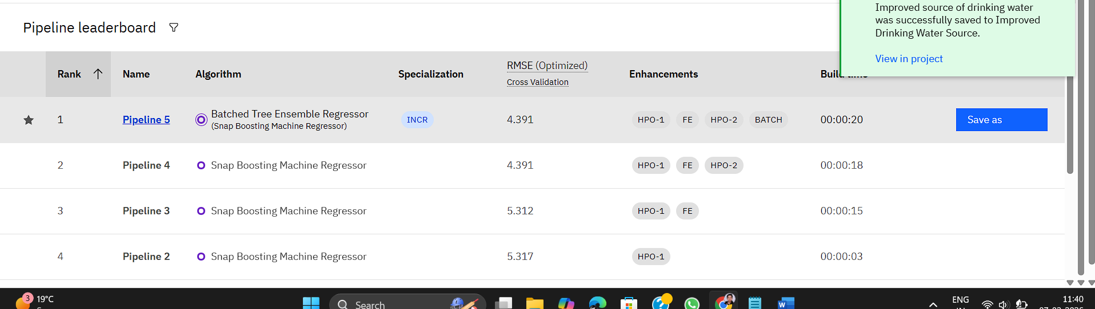
Result
Best Performing Model
The Snap Boosting Machine Regressor achieved a top-tier RMSE of 4.391 for predicting improved water sources. Pipeline 5 emerged as the best-performing model by utilizing a batched tree ensemble with hyperparameter optimization and feature engineering.

Slide 14
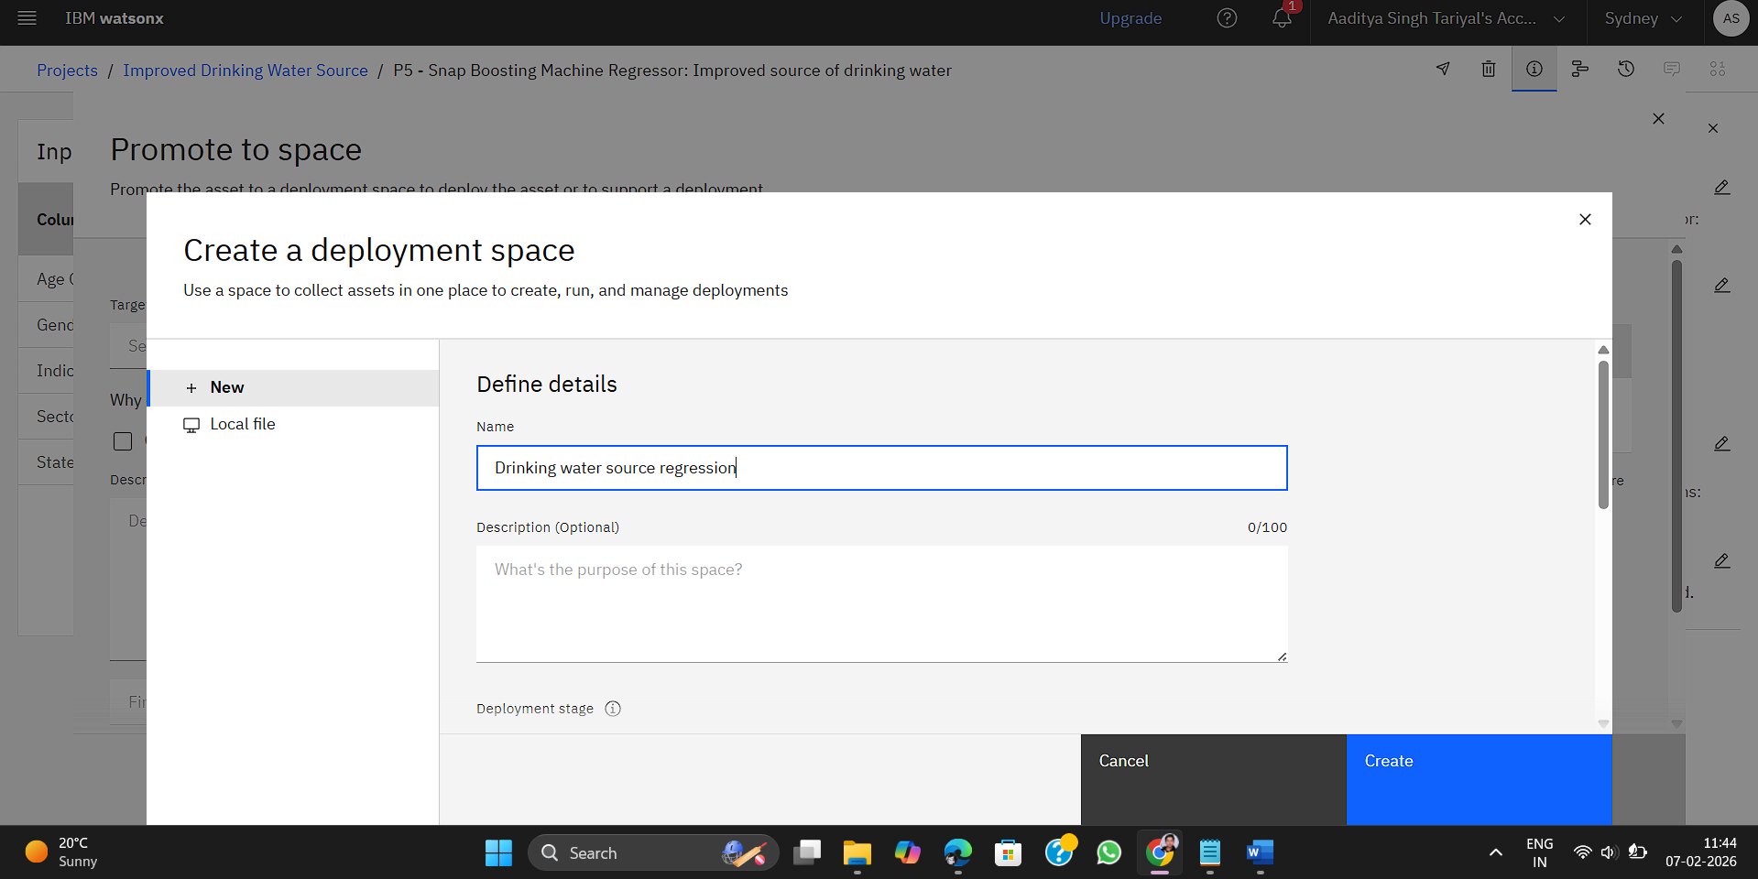
Deployment Phase

Slide 15
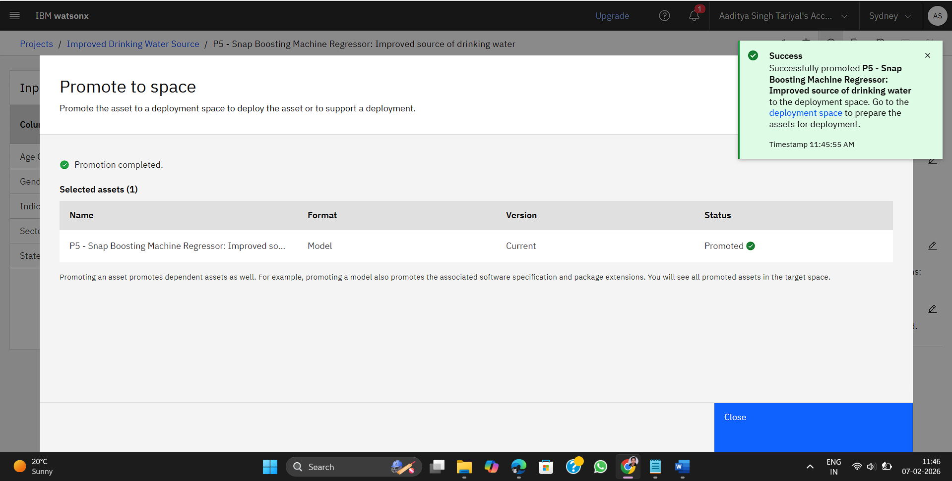
Deployment Phase

Slide 16
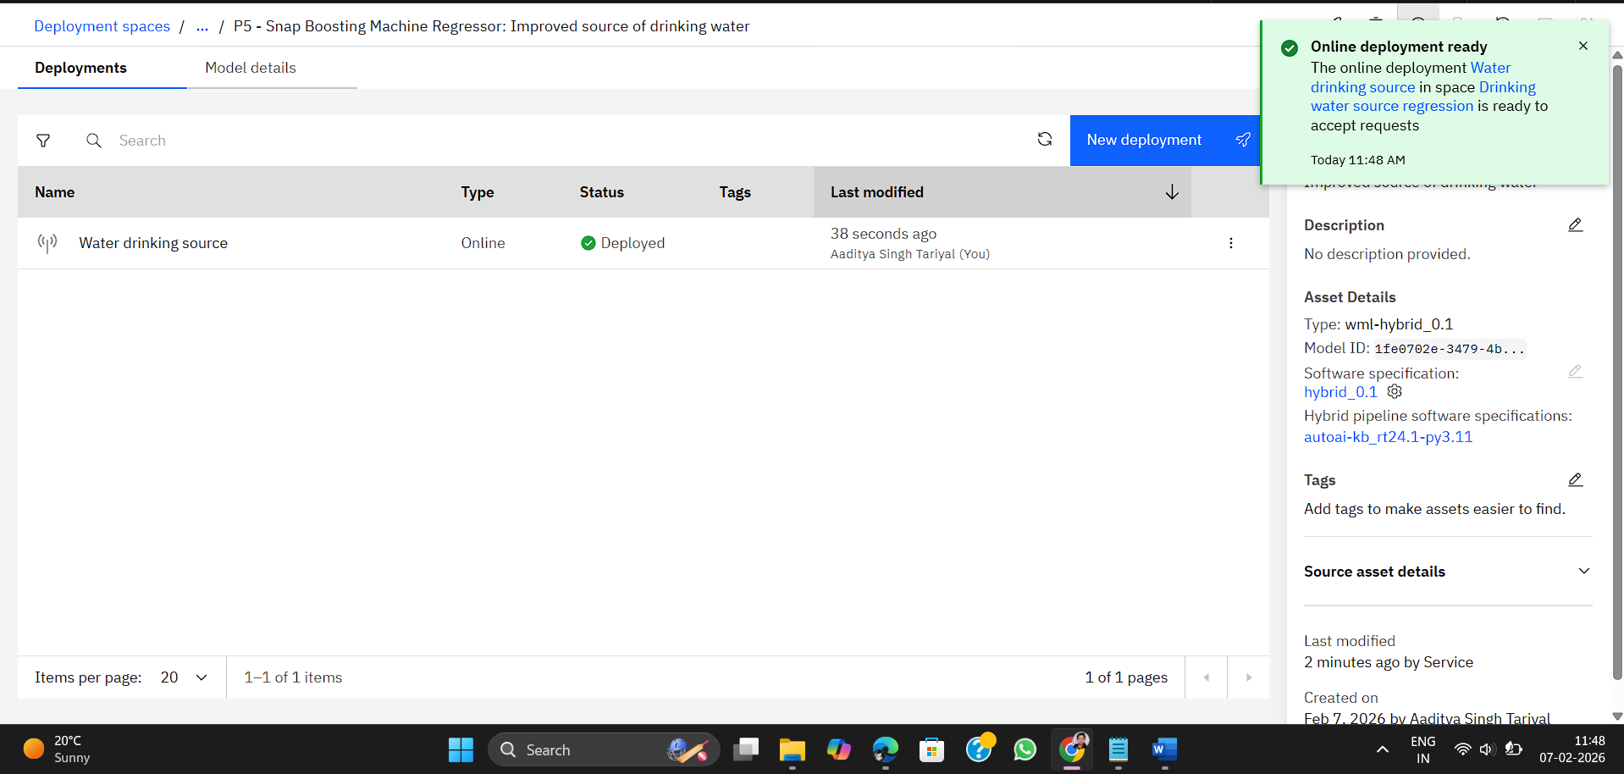
Deployment Phase
Deployment Successful
The model was successfully promoted from the AutoAI project and deployed as an Online Deployment within the specified deployment space. This generated a dedicated REST endpoint, enabling real-time scoring and integration into external applications via the watsonx.ai Runtime.

Slide 17
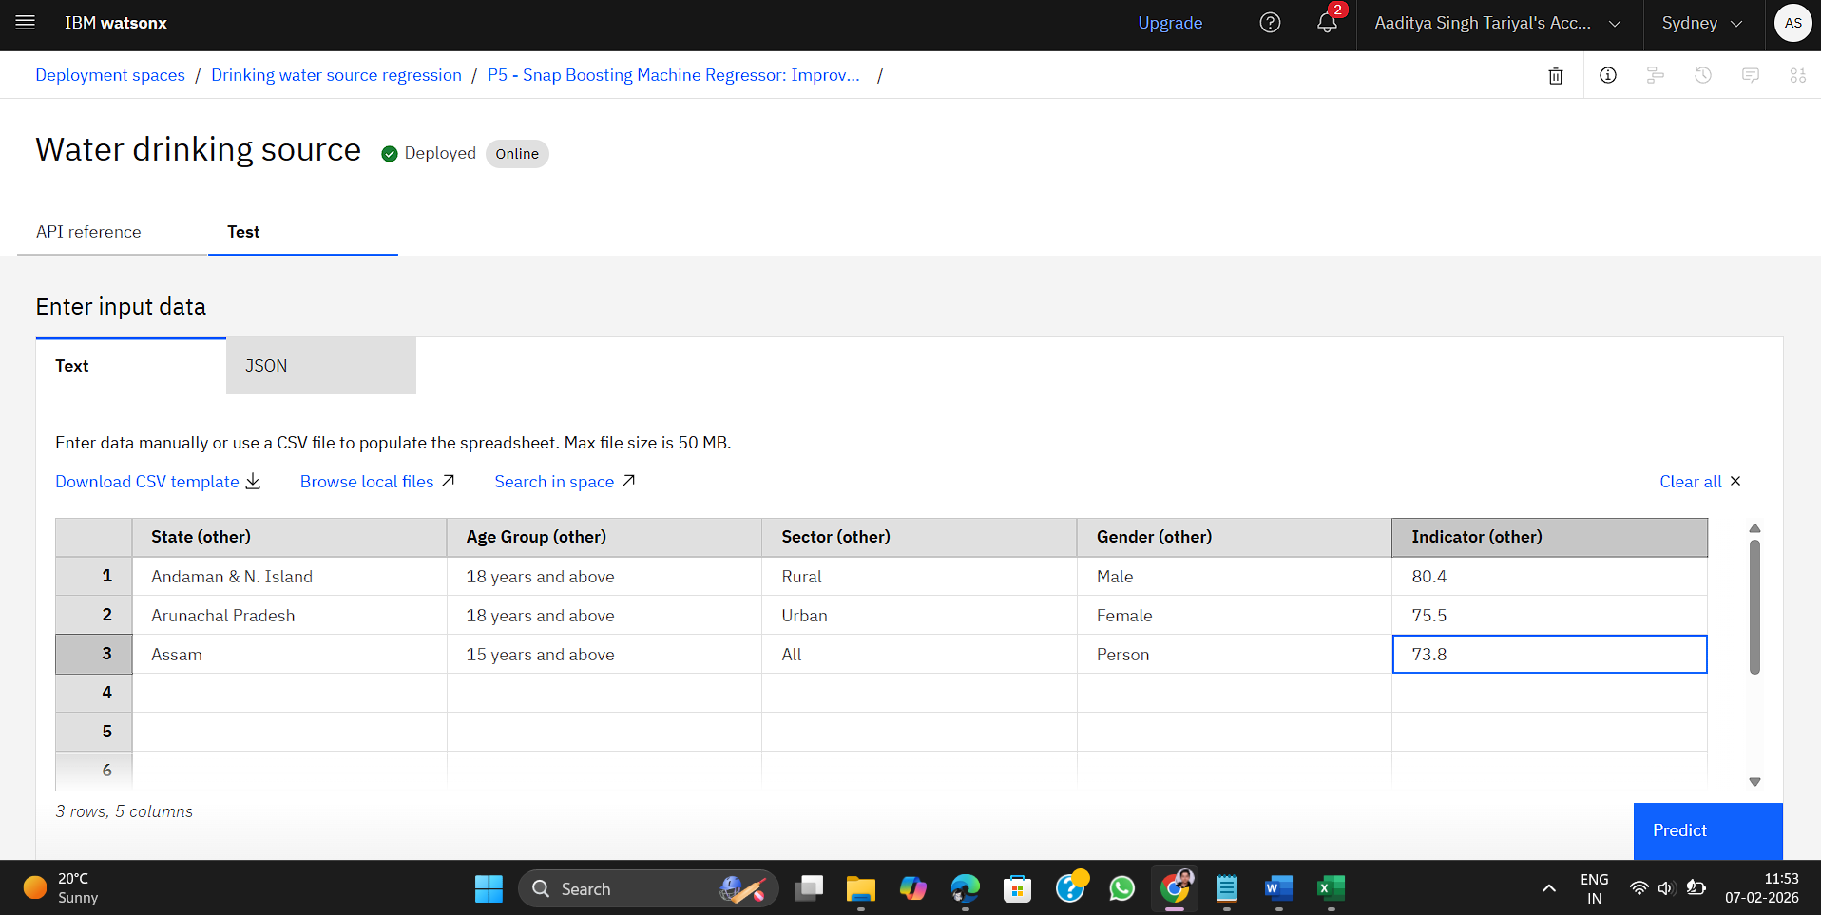
Testing Model
Data Input entered to test and predict over trained model

Slide 18
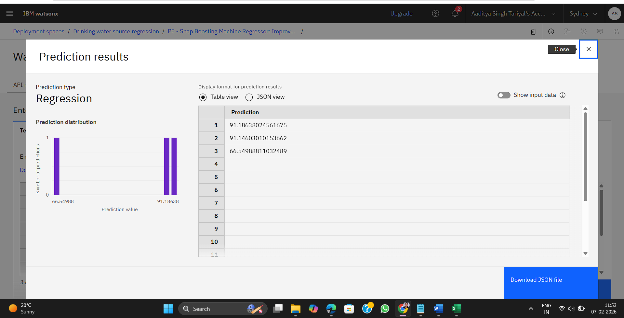
Testing Model
Prediction made over inserted data values by the best performing model

Slide 19
Conclusion
The Snap Boosting Machine Regressor achieved high predictive accuracy with an RMSE of 4.391, proving that AutoAI’s automated feature engineering and hyperparameter optimization significantly enhance model performance for water source analysis.
By successfully transitioning from the project environment to a watsonx deployment space, the model is now available via a REST endpoint, ready for seamless real-time integration and scalable decision-making.

Slide 20
Github link
https://github.com/AST119/Improved-Source-of-Drinking-Water-Regression

Slide 21
Future scope
Real-Time Data Integration: Incorporate live IoT sensor data and satellite imagery to transition from static survey analysis to real-time water quality and availability monitoring.
Cross-Indicator Analysis: Use the MIS 78th Round data to model the hidden correlations between water scarcity, migration patterns, and clean fuel adoption.
Geospatial Hotspot Mapping: Implement GIS visualization to identify specific regional "dark zones," enabling hyper-localized infrastructure planning.
Predictive Policy Simulators: Develop "what-if" dashboards on watsonx to help officials forecast the impact of specific budget allocations on SDG targets.

Slide 22
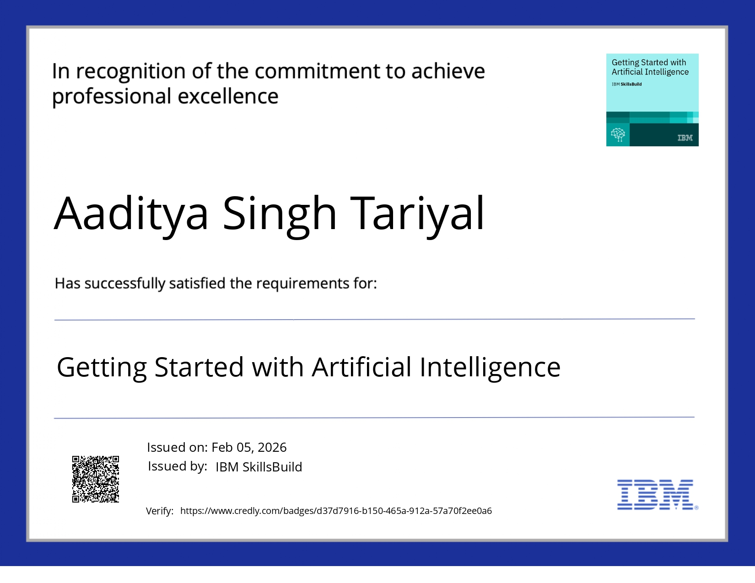
Ibm certifications

Slide 23
References
National Sample Survey Office (NSSO): Multiple Indicator Survey (MIS), 78th Round, Ministry of Statistics and Programme Implementation (MoSPI), Government of India.
United Nations SDG Indicators: Metadata and monitoring frameworks for Goal 6 (Clean Water and Sanitation) and Goal 7 (Affordable and Clean Energy).
IBM watsonx.ai Documentation: Technical guides for AutoAI, Snap Boosting Machine Regressor (Snap ML), and Hyperparameter Optimization (HPO) workflows.
Snap ML Research: “Snap Machine Learning” – Research papers detailing the high-performance ensemble methods used in the SnapBoost framework.
Sustainable Development Goals (SDG) India Index: Reports by NITI Aayog on regional disparities and water accessibility benchmarks across Indian states.

Slide 24
THANK YOU

